Slide 1

Prediction of Adult Income
Group 44
Student 1 - Tanishka Adhlakha
Student 2 - Krishna Barfiwala
Presentation Date – 04/21/2023

Slide 2
TABLE OF CONTENT
1. Introduction and Problem Setting
3. Data Sources
5. Data Exploration
7. Model Performance Evaluation and Interpretation
2. Problem Definition
4. Data Description
6. Data Mining Tasks
8. Conclusion

Slide 3

Introduction and Problem Setting
Low income of people has caused problems and concern in recent years.
In this project we will aim to conduct comprehensive analysis and highlight the main factors that are essential in improving unequal income of an individual.
Classification is performed to predict whether a person’s yearly income is greater than or less than 50k based on various sets of attributes and parameters.

Slide 4
Problem Definition
The aim of the project is to predict if the adult income is greater than 50K or less than and equal to 50K.
There are certain factors influencing the setting up a business in a city, which rely on the average income of people living in that city; Some other factors which affect the income of people are age, education, occupation, capital gain or loss, etc.
This helps us determine various things such as the scope of profit-making business, preferences of real estate and bank loans eligibility for every individual, the type of people who would like to visit any tourist place and whether the people living there would put their students in private or public colleges in future.
The goal of the project is to predict and extract as much information as possible from the data by using machine learning algorithms and finding appropriate patterns in the dataset using Association rules.

Slide 5

Data Sources
The prediction of Adult Income Based on Census Data has been taken from kaggle, an open source, secure online repository-
https://www.kaggle.com/datasets/wenruliu/adult-income-dataset

Slide 6
Data Description
The data for our study was accessed from the University of California Irvine (UCI) Machine Learning Repository.
The Datasets consist of 32561 instances (rows) and 15 attributes, each of which explains various features of a person along with his income per year.
The prediction task is to predict whether income exceeds $50k per year based on the provided. The dataset needs to be balanced with the target values so that the models do not overfit the data.
Few columns in the dataset include age, workclass, education, occupation, marital status, race, etc.

Slide 7
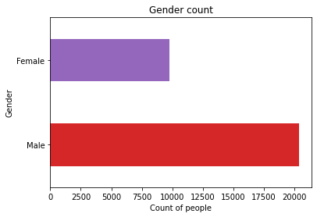
Data Exploration
Statistical and visualization methods used to explore data. The goal of data exploration is to gain a deeper understanding of the data and to identify potential relationships or patterns that can inform decision-making or further analysis.
Count of the number of people categorized as Males and Females:
Interpretation: Above plot interprets that there are more
number of male counts (approx 22000) as compared to
female counts (approx 8000) in our data set . We can
further use this information to analyze other columns
and perform observations.

Slide 8
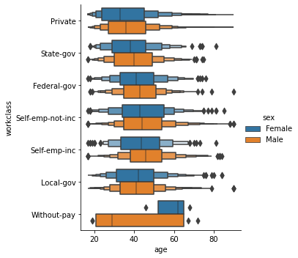
2. Difference in the Workclass and age with respective to Gender:
Interpretation: The females and males have almost equal mean, differing by a small value, for almost all the work classes except ‘Without-pay’. For the workclass ‘Without-pay’, the mean for females is relatively much higher than the males. The range for this work class is larger for males than females.

Slide 9
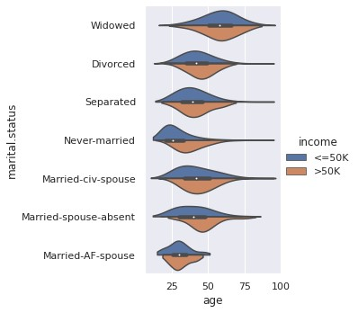
3. Proportion of Work class, Age classified in income:
Interpretation: The X-axis in this plot shows age and Y-axis shows the marital status. The shape of the graph indicates the spread of individuals in that category. Widowed people are highly spread over the age range. Married-AF spouses are least spread. The graph also shows the spread of people with income greater than , less than or equal to 50k.

Slide 10
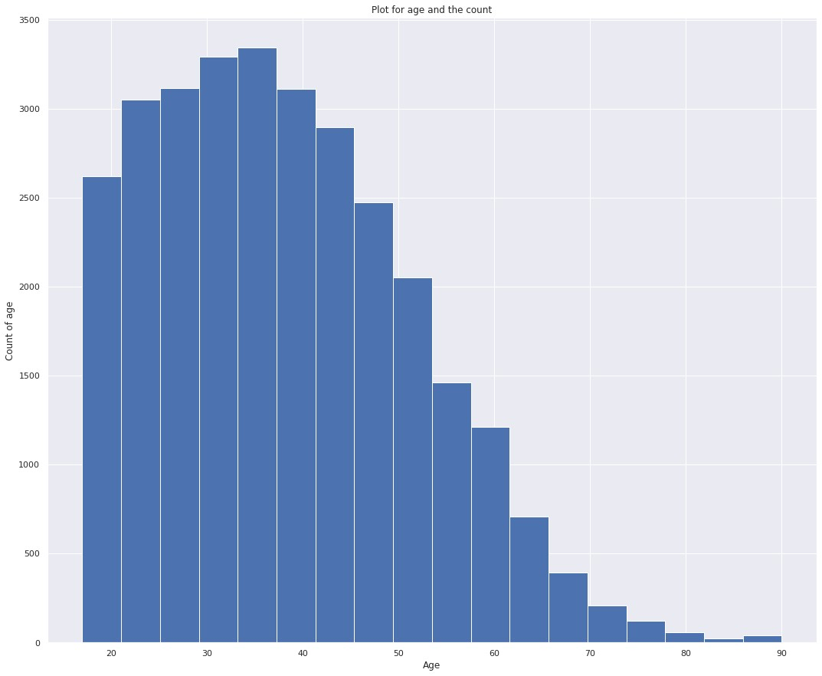
4. Distribution of age:
Interpretation: This plot shows a distribution of age and its count. It is seen the age distribution is right skewed and most of the population in the data are from the 20 to 50 age group.

Slide 11
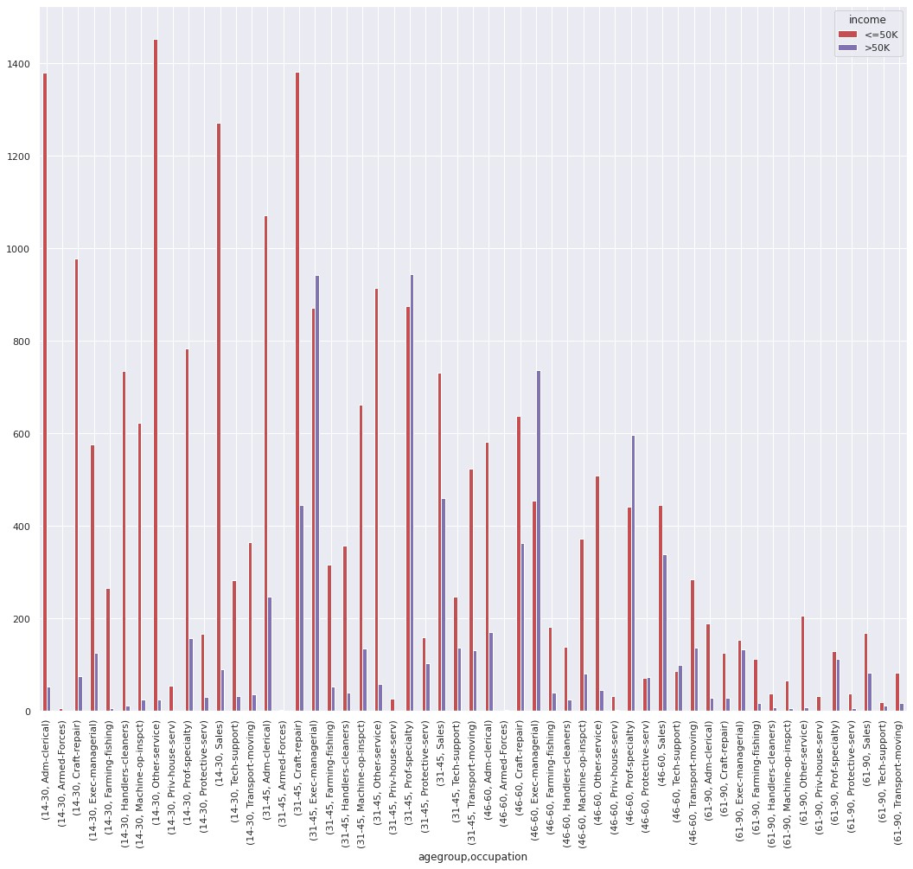
5. Age Group and occupation wise distribution:
Interpretation: The line in the graph represents the count of the people in that particular age group and occupation.
It is seen that in the age group 14-30, people working at other services are the maximum with income equal to or less than to 50k. For the age group 31-45, most people are working as Craft repair

Slide 12
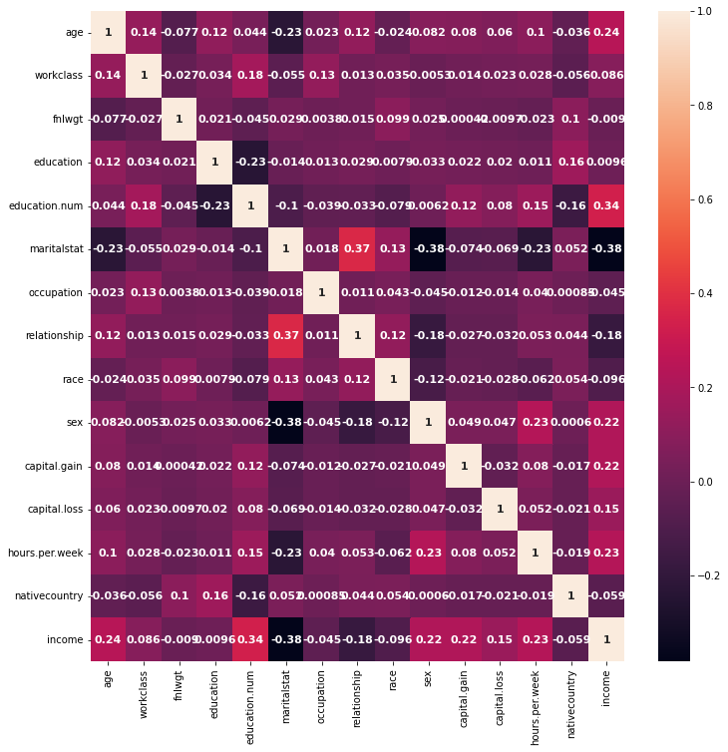
6. To check the Correlation between the variables:
Interpretation: This correlation map shows the correlation between the variables. The darker shades indicate the variables are negatively correlated and lighter shade includes it is positively correlated.
There is no strong relationship between any two variables.

Slide 13
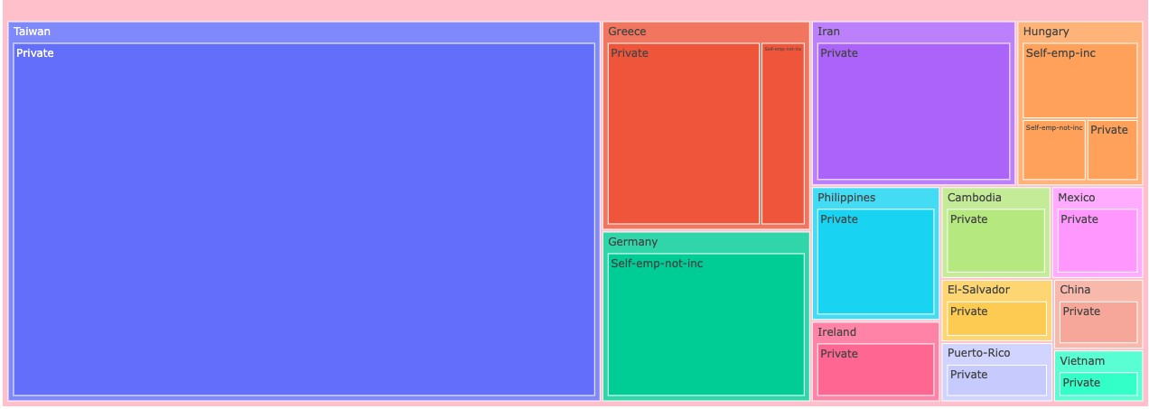
7. Tree map to show the capital gain country specific and their work-class:
Interpretation - Tree map shows hierarchical distribution of data based on native countries for top 5 and their work-class with highest values of capital gain of their respective countries. Taiwan has the highest capital gain with a greater number of private employees and Vietnam has the lowest capital gain with a greater number of private employees

Slide 14
Data Mining Tasks
Analysis of Missing Values - The analysis of missing data is important because it can affect the accuracy and validity of statistical analyses and machine learning models. Statistical description and information is obtained using the describe function.
Data Encoding - We converted categorical variables to numbers such that the model is able to understand and extract the information. Most machine learning models only accept numeric variables, preprocessing the categorical variables becomes a necessary step
Correlation Analysis - We have used Pearson correlation coefficient to evaluate the relationship between two and find the relationship between two or more variables. Correlation takes values between -1 and +1. A positive value for r indicates a positive association, and a negative value for r indicates a negative association. When r is 0, then there is no linear association between the variables.

Slide 15
Data Mining Tasks
Standardizing the Data - Data standardization is the process of rescaling the attributes so that they have mean as 0 and variance as 1. Standardization will bring the data to a common scale so that it allows the system to share and efficiently use data.
Principal Component Analysis - PCA will simplify the complexity in high dimension data while retaining the trends and patterns. Principal component analysis (PCA) is a technique for reducing the dimensionality of such datasets, increasing interpretability but at the same time minimizing information loss.
Statistical Analysis: A Pearson’s chi-square test is a statistical test for categorical data.

Slide 16

Model Performance Evaluation and Interpretation
Logistic Regression: In Logistic Regression, the main idea is to predict a dependent variable based on one or more independent variables. The Logistic regression uses a Sigmoid function which gives the probability of the outcome.
Advantages:
It is simple to understand and perform and does not require complex mathematical techniques.
Disadvantages:
Linear assumption: Logistic Regression assumes linearity between the independent variables, which might not hold true in all cases.

Slide 17
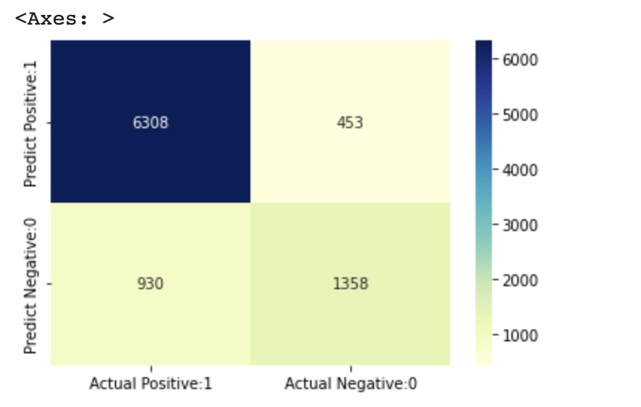
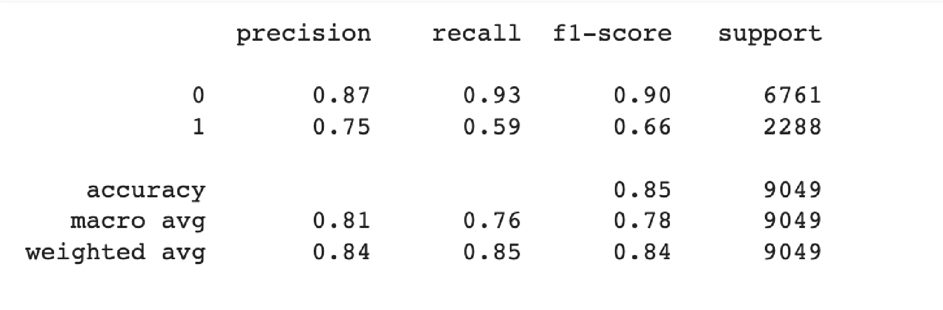
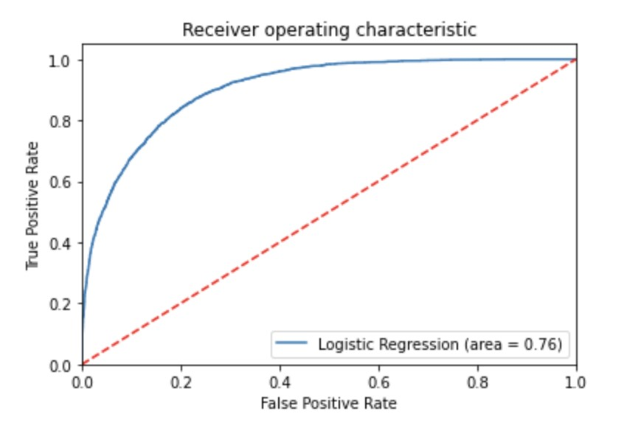
Interpretation: It can be seen the Logistic Regression model has an accuracy of 85%. The confusion matrix can be seen with a good number of True Positives and True Negatives. There are comparatively a smaller number of False Positives and False Negatives.
The ROC curve shows the graph of TPR vs the FPR at various thresholds. The area under the curve gives the classification model’s performance. As the ROC curve moves towards 1, it is considered as a perfect classifier. In this model, the ROC area curve is 0.76 indicating it is a good classifier. The Logistic regression classifier is a good model rather than random guessing.

Slide 18
Model Performance Evaluation and Interpretation
Naives Bayes: Naives Bayes is used to predict the certainty of an event occurring based on prior assumptions. This technique is applied by Naive Bayes to calculate the likelihood of each class a set of features, and the most likely class is then chosen as the final classification.
Advantages:
It can be performed on a small set of training data.
It performs relatively faster, than other models, for a large set of data. Disadvantages:
It assumes the features are independent of each other, even when they are not.
It may not perform well when there are outliers.

Slide 19
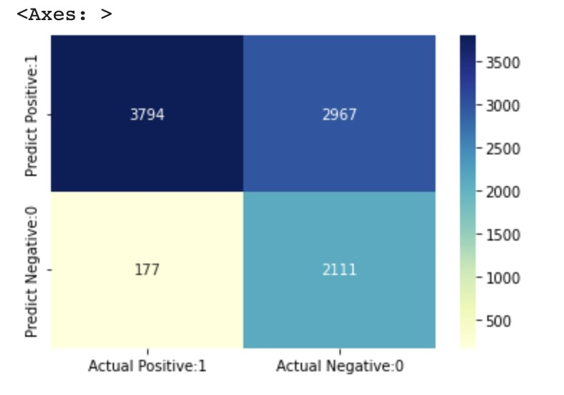
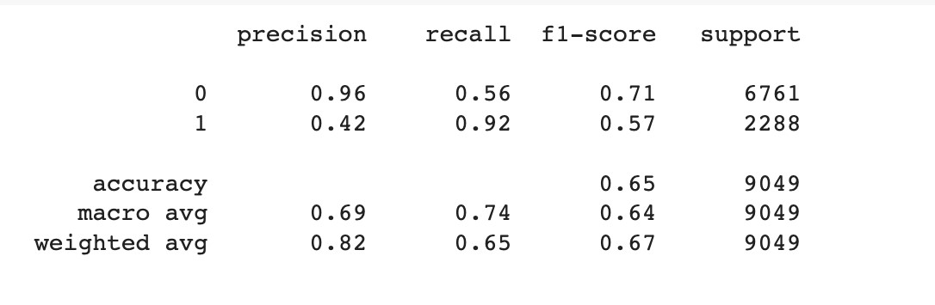
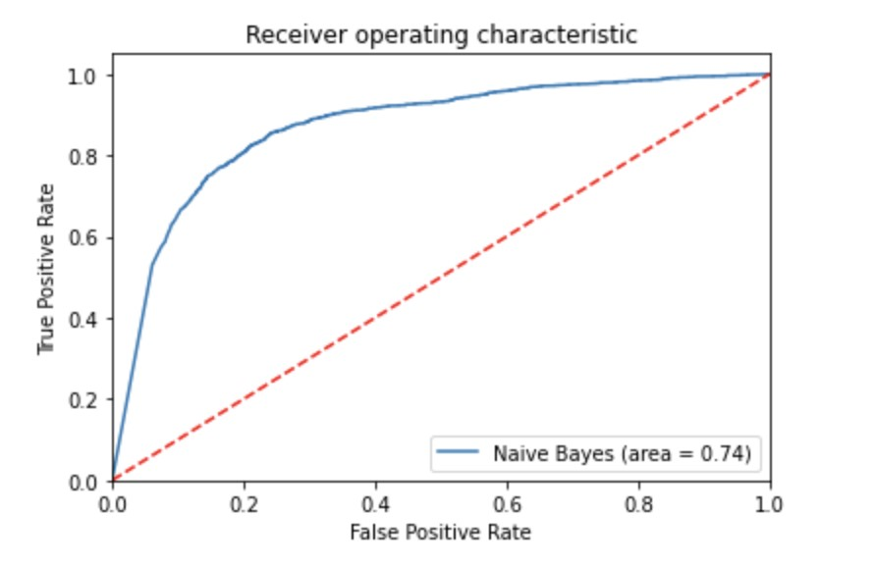
Interpretation - It can be seen the Naives Bayes model has an accuracy of 65%. The confusion matrix can be seen with a high number of False Positives, which is not considered to be a good characteristic of the model.
The ROC curve shows the graph of TPR vs the FPR at various thresholds. The area under the curve gives the classification model’s performance. As the ROC curve moves towards 1, it is considered as a perfect classifier. In this model, the ROC area curve is 0.74 indicating it is a good classifier. The Naives Bayes classifier is a good model if we consider the ROC curve individually. But since the accuracy and the confusion matrix numbers are not good, we cannot consider Naives Bayes as a good classifier for this dataset.

Slide 20
Model Performance Evaluation and Interpretation
KNN Classification : KNN Classification is a widely used method for evaluating machine learning models. In KNN classification, the algorithm assigns the class label to a new data point based on its distance to the K nearest neighbors in the training set.
Advantages:
Robust to noisy data and outliers in the training set
No training phase is required, so it can be applied directly to new data
Disadvantages:
For large datasets or high-dimensional data, KNN classifier is not suitable and can be expensive
Not suitable for imbalanced datasets, where one class has a much larger number of samples than the other classes

Slide 21
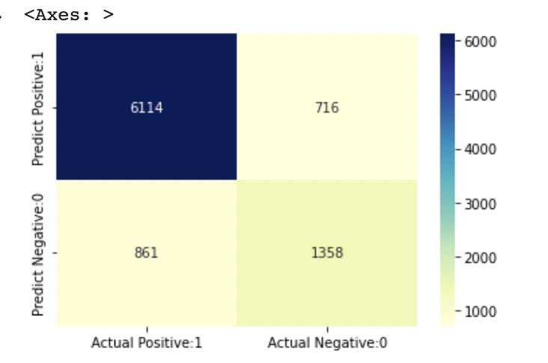
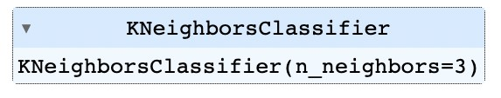
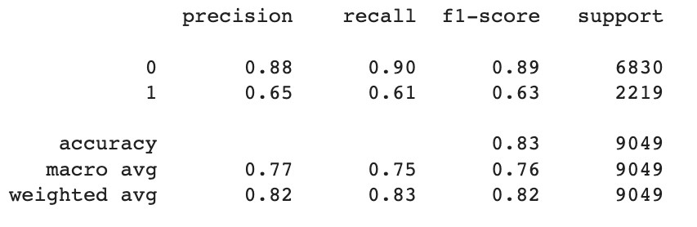
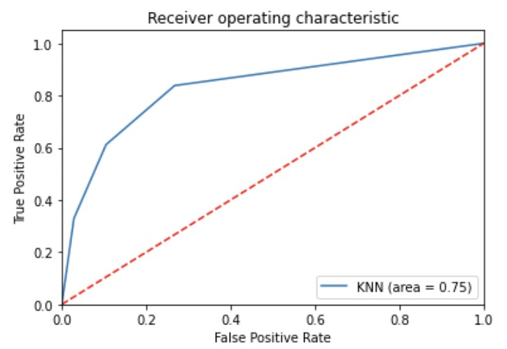
Interpretation - We calculated the accuracy, precision, recall and F1 score to find the performance of the model. The accuracy of the model is 83% and tells that it was able to classify 83% of the instances in the test dataset correctly. Accuracy and F1 score of KNN is less than SVC and Logistic Regression therefore it is not advisable to implement in the model.
The above ROC curve also has an area of 75% using KNN Classifier which is again lesser than SVC and Logistics model, indicating that the classifier with the 77% AUC has a better overall performance than the one with the 75% AUC.

Slide 22
Model Performance Evaluation and Interpretation
Support Vector Machine(SVM) : Supervised machine learning algorithm that is commonly used for classification and regression analysis.
Advantages:
Robust to outliers: SVM is relatively robust to outliers in the data because it tries to maximize the margin, which can help avoid overfitting.
Effective in high-dimensional spaces: SVM is effective in high-dimensional spaces
Disadvantages:
Computationally intensive: SVM can be computationally intensive, especially when dealing with large datasets or complex models.
Limited scalability: SVM can be limited in terms of scalability because it requires the entire dataset to be stored in memory to train the model

Slide 23
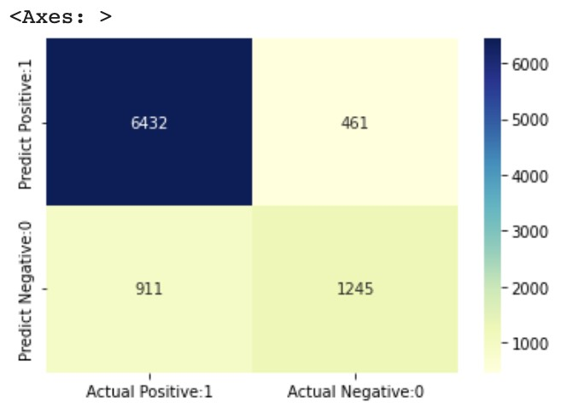
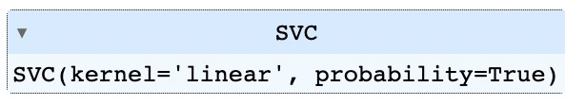
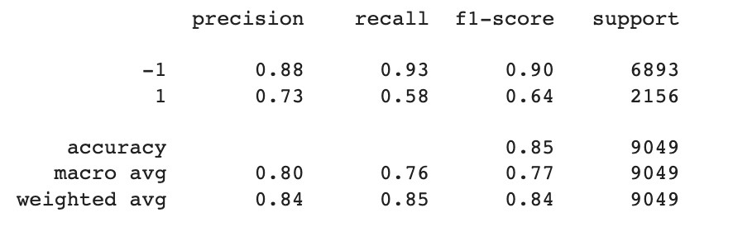
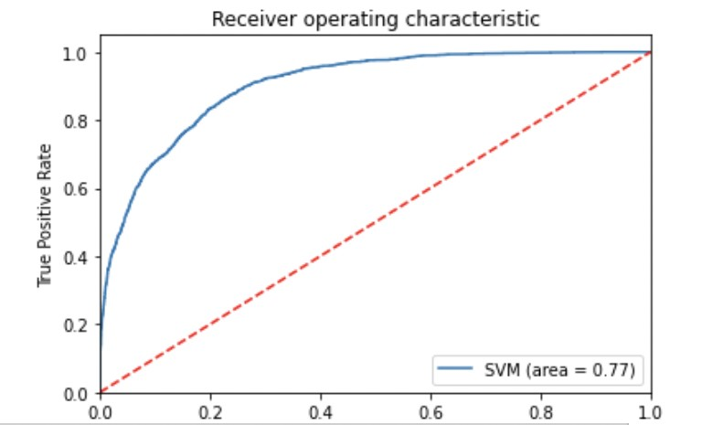
Interpretation - We calculated the accuracy, precision, recall and F1 score to find the performance of the SVM model. The accuracy of the model is 85% and tells that it was able to classify 85% of the instances in the test dataset correctly. Accuracy and F1 score of SVC is greater than KNN and Naives Bayes therefore it is not advisable to implement in the model.

Slide 24

Conclusion
Based on the above model predictions and comparison using various methods, we found that SVM has the highest accuracy with more percentage of AUC which tells that SVM is the best model selection to implement for this dataset.
SVM is a powerful and effective algorithm for classification tasks and is often the preferred choice for many applications. SVM is computationally efficient because it only considers a subset of the data points, called support vectors, which lie closest to the decision boundary.
This reduces the computational complexity of the algorithm and makes it scalable to large data sets.

Slide 25
Future Scope
The dataset was limited to categorical prediction, a continuous dependent variable would have been more useful for prediction.
Many other analysis could be done on the data like using other algorithms like Decision tree, Neural Networks, Random Forest, etc.
The relationships between the attributes have many possibilities. The models could be also handled in many different was for example other scoring and testing algorithms could be used.

Slide 26

THANK YOU ☺

